Slide 1
Operating Systems Sub Code:18CS43
Faculty Name : Sougandhika Narayan
Asst. Professor, Department of CSE
KSIT, Bangalore

Slide 2
Segmentation
Memory-management scheme that supports user view of memory.
A program is a collection of segments. A segment is a logical unit such as:
main program
procedure
function
method
object
local variables/ global variables
common block
stack
symbol table/ arrays

Slide 3
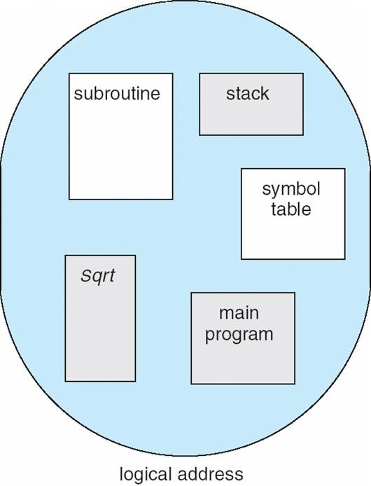
User’s View of a Program

Slide 4
Logical View of Segmentation
1
4
2
3
1
2
3
4
user space
physical memory space

Slide 5
Segmentation Architecture
Logical address consists of a two tuple:
<segment-number, offset>,
Segment table – maps two-dimensional physical addresses; each table entry has:
base – contains the starting physical address where the segments reside in memory
limit – specifies the length of the segment
Segment-table base register (STBR) points to the segment
table’s location in memory
Segment-table length register (STLR) indicates number of segments used by a program;
segment number s is legal if s < STLR

Slide 6
Segmentation Architecture (Cont.)
Protection
With each entry in segment table associate:
validation bit = 0 ⇒ illegal segment
read/write/execute privileges
Protection bits associated with segments; code sharing occurs at segment level
Since segments vary in length, memory allocation is a dynamic storage-allocation problem
A segmentation example is shown in the following diagram

Slide 7
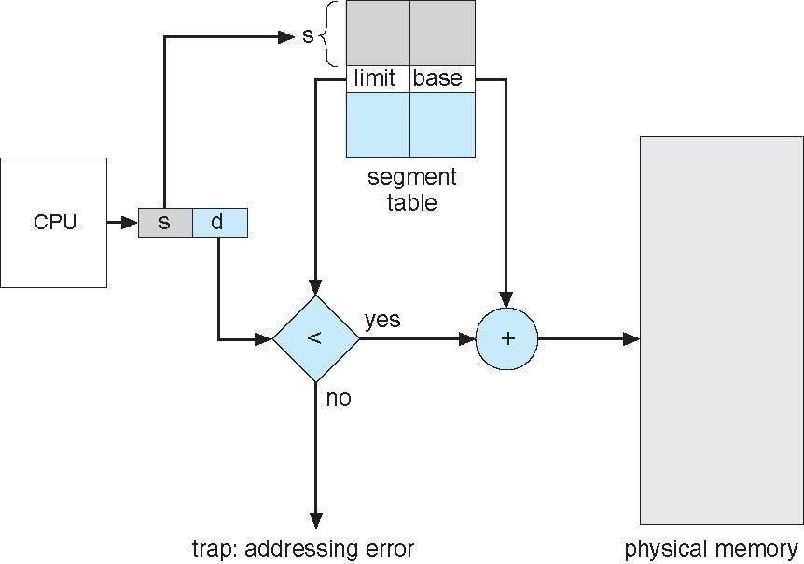
Segmentation Hardware
Segmentation Hardware

Slide 8
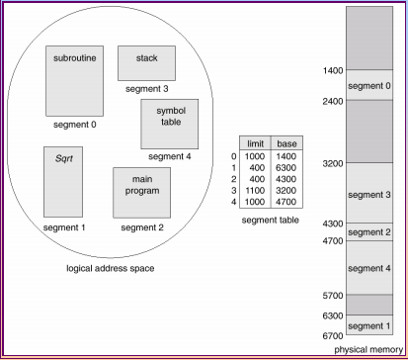
Example of Segmentation

Slide 9
Virtual Memory
A technique that allows the execution of processes that are not completely in memory.
It abstracts main memory into an extremely large, uniform array of storage, separating logical memory as viewed by the user from physical memory.

Slide 10
Goal of memory-management strategies:
keep many processes in main memory to allow multi-programming
Problem: Entire processes must be in memory before they can execute
Virtual Memory technique: running process need not be in memory entirely
Programs can be larger than physical memory
Abstraction of main memory; need not concern with storage limitations
Allows easy sharing of files and memory
Provide efficient mechanism for process creation

Slide 11
Background
Code needs to be in memory to execute, but entire program rarely used
Error code, unusual routines, large data structures; are all seldom used
Ex: declared array of size 100 cells but only 10 cells are used
Entire program code not needed (in main memory) at the same time Consider ability to execute partially-loaded program
Program no longer constrained by limits of physical memory Each program takes less memory while running
Thus, more [partially-loaded] programs can run at the same time
Increased CPU utilization and throughput with no increase in response
time or turnaround time; more multi-programming and time-sharing
Less I/O needed to load or swap programs into/from memory
Thus, each user program would run faster

Slide 12
Background
Virtual memory – separation of user logical memory from physical memory
As perceived by users; that programs exist in contiguous memory
Abstracts physical memory: need not worry about memory requirements
Only part of the program needs to be in memory for execution
Logical address space can therefore be much larger than physical address space
Programmers can work as if memory is an unlimited resource Allows address spaces to be shared by several processes
Allows for more efficient process creation
More programs running concurrently; increased multi-programming and/or time-sharing Less I/O needed to load or swap processes; hence, faster program execution

Slide 13
Background (Cont.)
Virtual address space – logical view of how process is stored in memory
Process starts at address 0 with contiguous addresses until end of its address space Meanwhile, physical memory organized in page frames; not contiguous
MMU maps logical pages to physical pages (i.e., frames) in memory
Virtual memory can be implemented via:
Demand paging
Demand segmentation

Slide 14
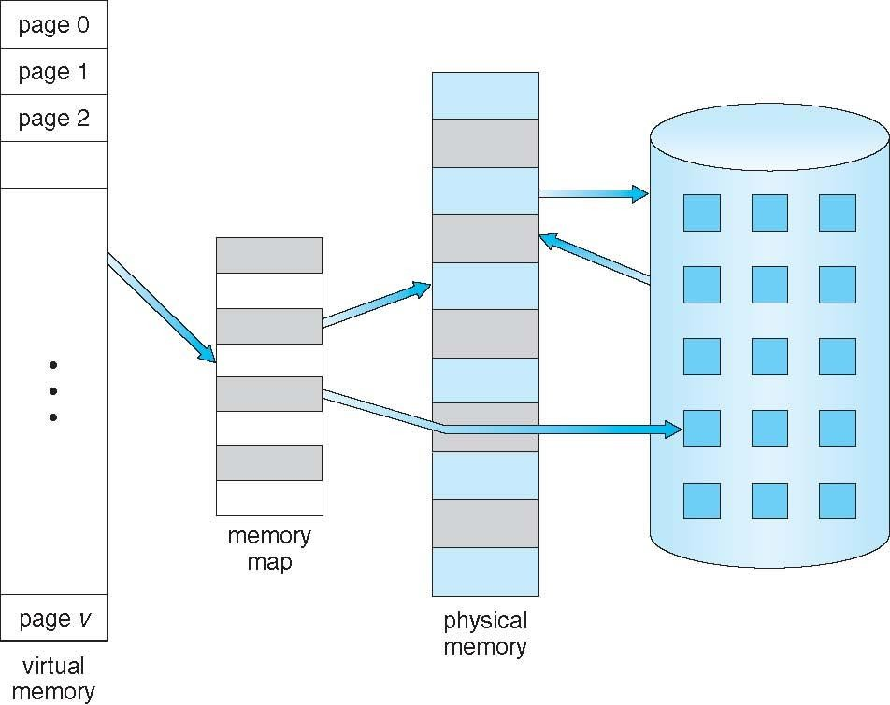
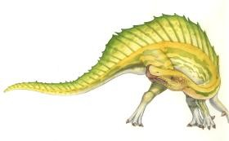
Virtual Memory That is Larger Than Physical Memory

Slide 15
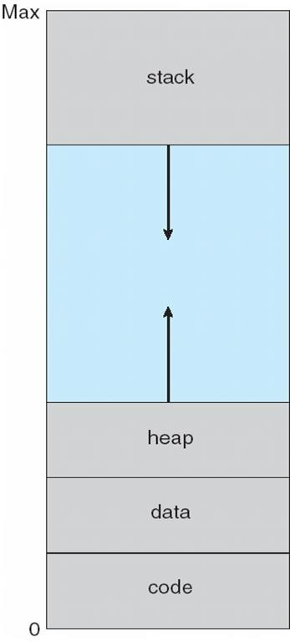
Virtual-Address Space of a Process
For a process: heap grows upward while stack grows downward in memory; in process’s space
Unused address space between the two is a hole; part of virtual-address space
 Require actual physical pages only if the heap or the stack grow
 Maximizes address space use
Enables sparse address spaces with holes left
for growth, or to dynamically link libraries, etc
System libraries can be shared by many processes through mapping of the shared objects into virtual address space
Processes can share memory by mapping read-
write pages into virtual address space
Pages can be shared during process creation with the fork(); speeding up process creation

Slide 16
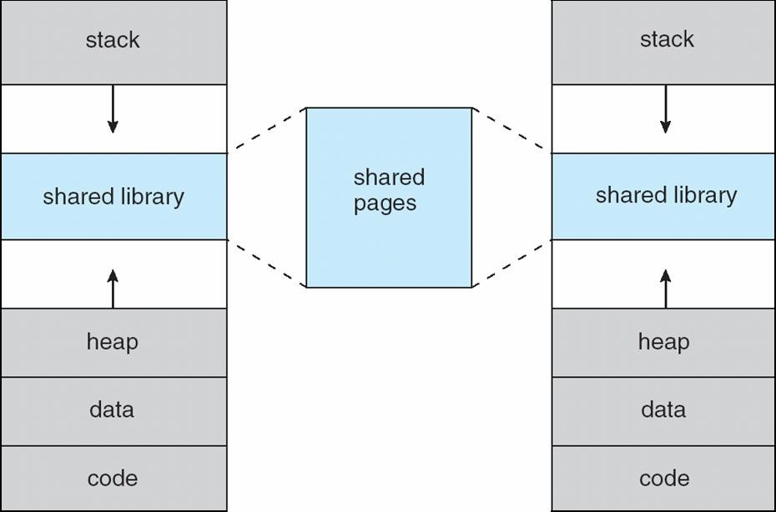
Shared Library Using Virtual Memory

Slide 17
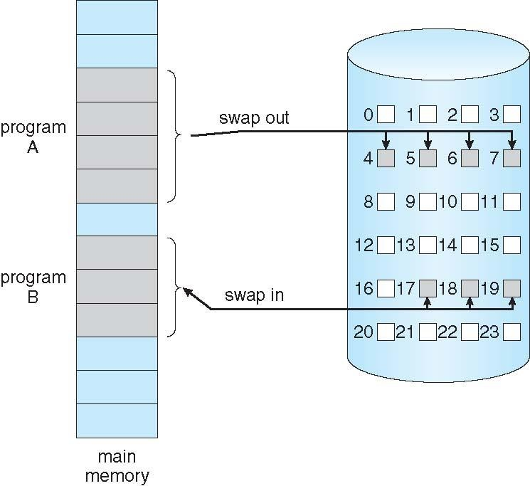
Demand Paging
Could bring an entire process into memory at load time.
Or bring a process’s page into memory only when it is needed
Less I/O needed, no unnecessary I/O Less memory needed
Faster response More users
Similar to a paging system with swapping (diagram on right)
Lazy swapper – never swaps a page into memory unless page will be needed
Swapper that deals with pages is a pager
Page is needed ⇒ reference it;
invalid reference ⇒ abort
not-in-memory ⇒ bring to memory

Slide 18
Basic Concepts
When swapping in a process, the pager guesses which pages will be used before swapping it out again
The pager brings in only those needed pages into memory
Thus, decreases swap time and amount of needed physical memory
Need new MMU hardware support to implement demand paging;
To distinguish between in-memory pages and on-disk pages
Uses the valid—invalid scheme
If pages needed are already memory resident
Execution proceeds normally
If page needed and is not memory resident;
Need to find the needed page from the disk and load it into memory
Without changing program behavior
Without programmer needing to change code

Slide 19
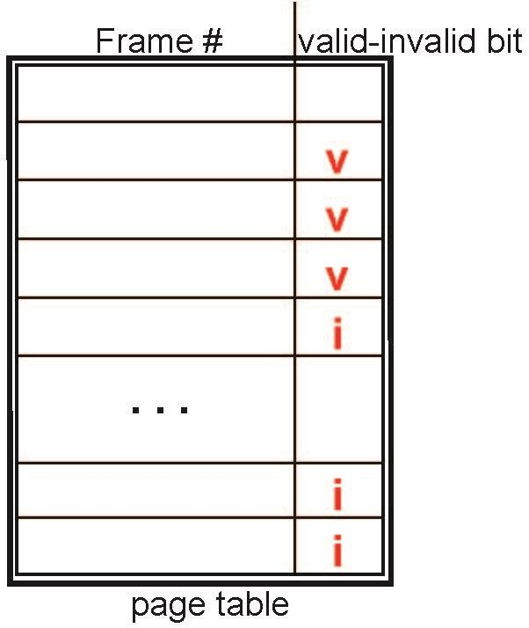
Valid-Invalid Bit
A valid–invalid bit is associated with each page-table entry;
(v ⇒ in-memory – memory resident ; i ⇒ not-in-memory)
Initially valid–invalid bit is set to i on all entries Example of a page table snapshot:
During MMU address translation:
if valid–invalid bit in page-table entry is i ⇒ there is a page fault

Slide 20
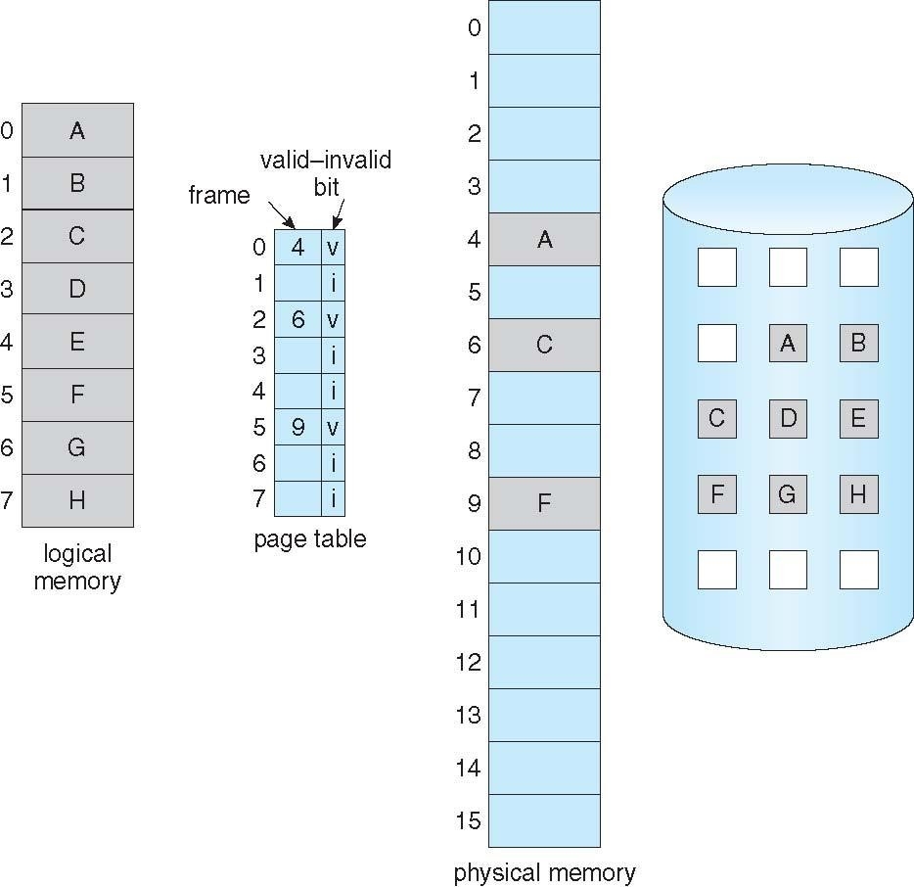
Page Table When Some Pages Are Not in Main Memory

Slide 21
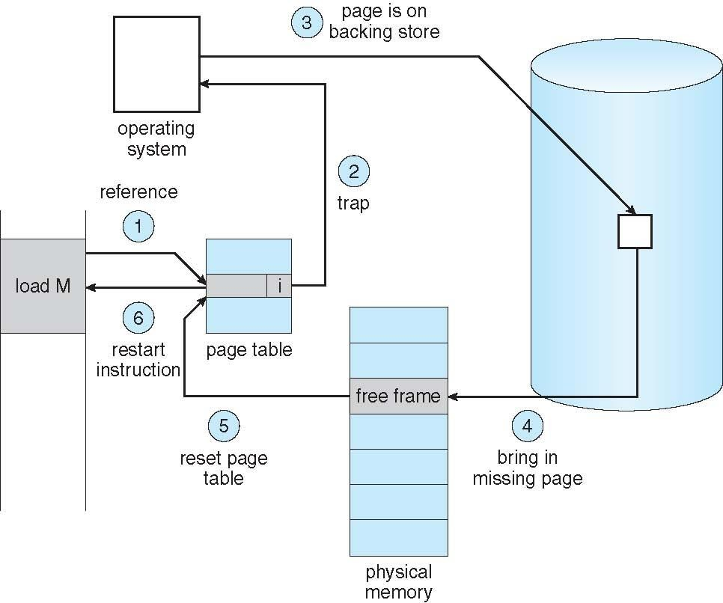
Page Fault
What if the process refers to (i.e., tries to access) a page not in-memory ?
The [first] reference (i.e., address) to that invalid page will trap to operating system and causes a page fault
Procedure for handling a page fault
OS checks an internal table to see if reference is valid or invalid memory access
If
Invalid reference ⇒ abort the process
address is not in logical address space of process
Just not in memory ⇒ page in the referred page from the disk
logical address is valid but page is simply not in-memory
Find a free frame;
Read the referred page into this allocated frame via scheduled disk operation
Update both internal table and page-table by setting validation bit = v
Restart the instruction that caused the page fault and resume process execution

Slide 22
Steps in Handling a Page Fault

Slide 23
Aspects of Demand Paging
Extreme case – start process with no pages in memory
OS sets instruction pointer to first instruction of process; logical address = (p, d)
Since page p is non-memory-resident then a page fault is issued
Page p is loaded and… same for all other process pages on first reference This scheme is pure demand paging: load a page only when it is needed
A given instruction may refer to multiple distinct pages; thus, multiple page faults Consider fetching the instruction “ADD A, B” and fetching the values of data
A and B from memory and then storing the result back to memory
Addresses of “ADD A, B”, “A”, and “B” may all be in three different pages Multiple page fault per instruction results in unacceptable performance
Very unlikely, fortunately, due to locality of reference;
Hardware support needed for demand paging; same as hardware for paging and swapping
Page table with valid / invalid bit, or special protection bits
Secondary memory: swap device with swap space; for not in-memory pages
Instruction restart; ability to restart any instruction after a page fault

Slide 24
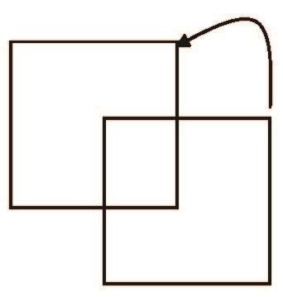
Instruction Restart
Consider an instruction that could access several different locations
block move
auto increment/decrement location
Restart the whole operation?
 What if source and destination overlap?

Slide 25
Performance of Demand Paging
What is the Effective Access Time in demand paging? (worst case number of steps)
Trap to the operating system
Save the user registers and process state
Determine that the interrupt was a page fault
Check that the page reference was legal and determine the location of the page on the disk
Issue a read from the disk to a free frame:
Wait in a queue for this device until the read request is serviced
Wait for the device seek and/or latency time
Begin the transfer of the page to a free frame
While waiting, allocate the CPU to some other user (CPU scheduling, optional)
Receive an interrupt from the disk I/O subsystem (I/O completed)
Save the registers and process state for the other user (if Step-6 is executed)
Determine that the interrupt was from the disk
Correct the page table and other tables to show page is now in memory
Wait for the CPU to be allocated to this process again
Restore the user registers, process state, and new page table, and then resume the interrupted instruction

Slide 26
Performance of Demand Paging
Not all steps are necessary in every case; e.g., Step-6
Three major components of the page-fault service-time
Service the interrupt; between 1 to 100 microseconds
 Careful coding of the ISR means just several hundred instructions needed
Read in the page – lots of time; at least 8 milliseconds + time in device-queue + …
Restart the process; between 1 to 100 microseconds – again, careful coding…
Page Fault Rate 0 ≤ p ≤ 1; p = probability of a page-fault and we expect p ≈ 0
if p = 0 if p = 1
then there is no page faults
then every memory reference causes a page-fault
Effective Access Time (EAT)
EAT = [ (1 – p) × memory_access_time ] + [ p ×page_fault_time ]
 page_fault_time = page fault overhead + swap page out + swap page in

Slide 27
Demand Paging Example
Memory access time = 200 nanoseconds; between 10 to 200ns in most computers
Average page-fault service time = 8 milliseconds
EAT = [ (1 – p) × (200 nanoseconds) ] + [ p × (8 milliseconds) ]
= [ (1 – p) × 200 ] + [ p × 8,000,000 ] nanoseconds
= 200 + 7,999,800p nanoseconds; thus, EAT is directly proportional to p
If one access out of 1,000 causes a page fault, then EAT = 8,199.8 nanoseconds = 8.2 microseconds.
 This is a slowdown by a factor of 40!!; Because of demand paging
If want performance degradation < 10 percent 220 > 200 + 7,999,800 × p
20 > 7,999,800 × p
Thus, we must have p < .0000025
That is, to keep slowdown due to demand paging
 p < one page fault in every 399,990 memory accesses

Slide 28
Demand Paging Optimizations
Swap space I/O faster than file system I/O even if on the same device
Swap allocated in larger chunks, less management needed than file system Copy entire process image to swap space at process load time
Then page in and out of swap space Used in older BSD Unix
Demand page in from program binary on disk, but discard rather than paging out when freeing frame
Used in Solaris and current BSD
Still need to write to swap space
Pages not associated with a file (like stack and heap) – anonymous memory
Pages modified in memory but not yet written back to the file system
Mobile systems
Typically don’t support swapping
Instead, demand page from file system and reclaim read-only pages (such as code)

Slide 29
Copy-on-Write
Copy-on-Write (COW) allows both parent and child processes to initially share
the same pages in memory
If either process modifies a shared page, only then is the page copied
COW allows more efficient process creation as only modified pages are copied In general, free pages are allocated from a pool of zero-fill-on-demand pages
Pool should always have free frames for fast demand page execution
 Don’t want to have to free a frame as well as other processing on page fault
Why zero-out a page before allocating it?
vfork() variation on fork() system call has parent suspended and child using
copy-on-write address space of parent
Designed to have child call exec()
Very efficient

Slide 30
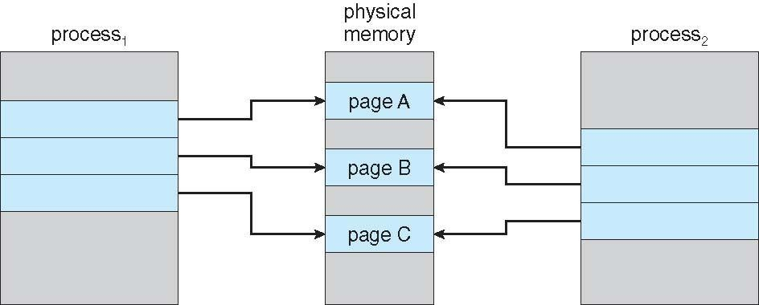
Before Process 1 Modifies Page C

Slide 31
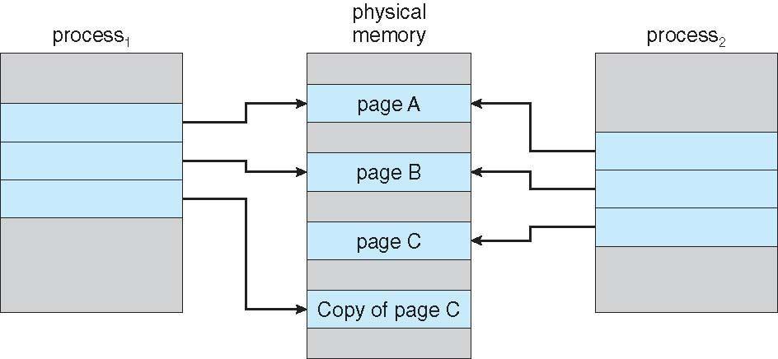
After Process 1 Modifies Page C

Slide 32
What Happens if There is no Free Frame?
Many pages need to be loaded but not enough free frames available fro them
Memory is being used up by process pages; both, user and kernel processes Also memory is in demand from the kernel, I/O buffers, etc
How much memory to allocate to I/O buffers, kernel, processes, … , etc
Solution: Page replacement; when paging in pages of a process but no free frames
Terminate the process? Swap out some process?
Big fat no
Yes, but not always a good option
Find currently un-used frame to free it; Page it out and page in process page
 Replacing the un-used memory page with the new page
Performance – want an algorithm which will result in minimum number of page faults
Same page may be brought into memory several times

Slide 33
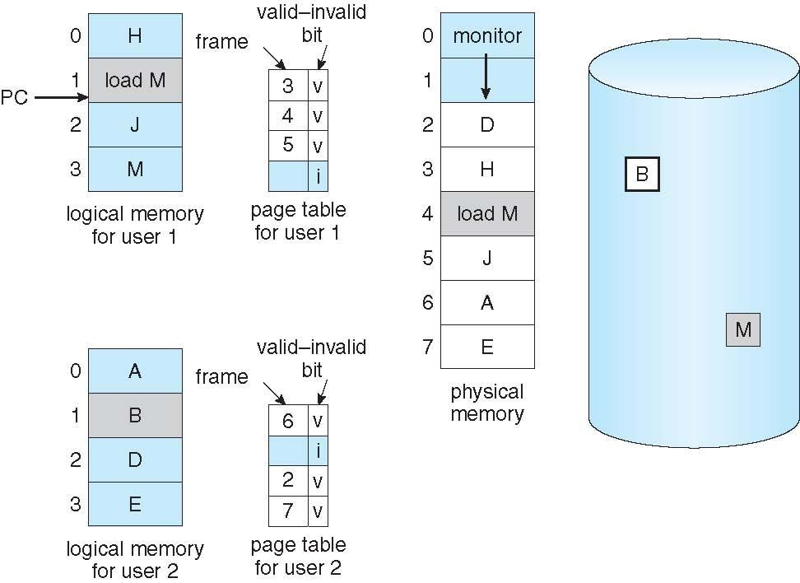
Need For Page Replacement

Slide 34
Basic Page Replacement Algorithm
The page-fault service routine is modified to include page replacement
Find the location of the desired page on disk
Find a free frame:
If there is a free frame, use it
If there is no free frame, use a page-replacement algorithm to select a
victim frame
Write the victim frame to the disk [if dirty]; change the page and the frame tables accordingly
Read the desired page into the newly freed frame; change the page and frame tables
Continue the user process from where the page fault occurred
We have potentially two page transfers to do – increasing EAT
Only if no frames are free; one page in required and one page out required

Slide 35
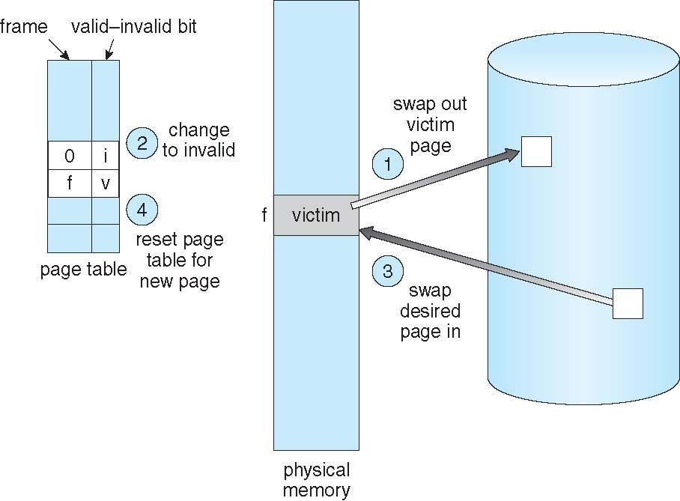
Page Replacement

Slide 36
Page Replacement …
Prevent over-allocation of memory by modifying page-fault service routine to include page replacement
Use modify (dirty) bit to reduce overhead of page transfers – only modified
pages are written to disk ;
Each page or frame is associated with a modify bit
Set by the hardware whenever a page is modified
Page replacement completes separation between logical memory and physical memory – large virtual memory can be provided on a smaller physical memory
A user process of 20 pages can be executed in 10 frames simply by using demand-paging and using a page-replacement algorithm to find a free frame whenever necessary

Slide 37
Page- Replacement and Frame-Allocation Algorithms
Two major demand-paging problems : frame allocation and page replacement
Frame-allocation algorithm determines
How many frames to allocate to each process
Which frames to replace; when page replacement is required
Page-replacement algorithm
We want an algorithm which yields the lowest page-fault rate
Evaluate an algorithm by running it on a particular string of memory references (the reference string) and computing the number of page faults on that string
String is just page numbers p, not full addresses
Repeated access to the same page does not cause a page fault Results depend on number of frames available
In all our examples, the reference string of referenced page numbers is
7,0,1,2,0,3,0,4,2,3,0,3,0,3,2,1,2,0,1,7,0,1
for a memory with three frames

Slide 38
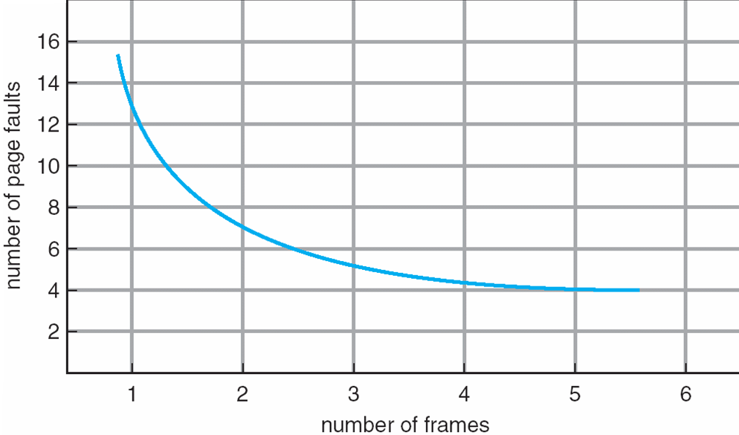
Graph of Page Faults Versus The Number of Frames

Slide 39
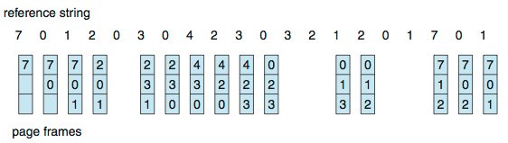
FIFO Page Replacement Algorithm Reference string = 7,0,1,2,0,3,0,4,2,3,0,3,0,3,2,1,2,0,1,7,0,1 and Memory = 3 frames]
Each page brought into memory is also inserted into a first-in first-out queue
Page to be replaced is the oldest page; the one at the head of the queue Our example yields 15 page faults
Can vary by reference string: consider 1,2,3,4,1,2,5,1,2,3,4,5
Adding more frames can cause more page faults!
 Belady’s Anomaly

Slide 40
Belady’s Anomaly
Generally, on increasing the number of frames to a process’ virtual memory, its execution becomes faster as less number of page faults occur. Sometimes the reverse happens, i.e. more number of page faults occur when more frames are allocated to a process. This most unexpected result is termed as Belady’s Anomaly.

Slide 41






FIFO Illustrating Belady’s Anomaly

Slide 42

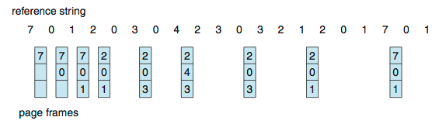
Optimal Page Replacement Algorithm [Reference string = 7,0,1,2,0,3,0,4,2,3,0,3,0,3,2,1,2,0,1,7,0,1 and Memory = 3 frames]
Replace the page that will not be used for longest period of time
Our example yields 9 page faults
Unfortunately, OPR is not feasible to implement
Because: we can’t know the future; i.e., what is the next page?
 We have assumed that we know the reference string. No, we don’t
OPR is used only for comparing with new algorithms; how close to the optimal?

Slide 43
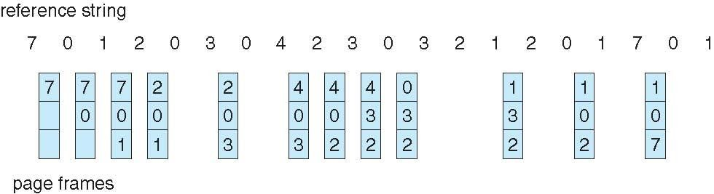
LRU Page Replacement Algorithm [Reference string = 7,0,1,2,0,3,0,4,2,3,0,3,0,3,2,1,2,0,1,7,0,1 and Memory = 3 frames]
Use the recent past as an approximation of the near future
Replace the page that has not been used for the longest period of time That is, the least recently used page
Associate time of last use with each page
Our example yields 12 page faults – better than FIFO but worse than OPT Generally good algorithm and frequently used
Algorithm is feasible but not easy to implement.
LRU algorithm may require substantial hardware support

Slide 44
LRU Algorithm
Counter implementation
Each page-table entry has a counter; every time the page is referenced through this entry, copy the current clock value into the counter
When a page needs to be changed, look at the counters to find smallest value
 Search through the page-table needed; to find the LRU page
Stack implementation
Keep a stack of page numbers in a double link form, with head and tail pointers:
Whenever a page is referenced:
move it to the top; most recently used page is always at the top of stack
requires 6 pointers to be changed But each update more expensive
No search for replacement; as LRU page is always at the bottom of the stack
LRU and OPT are cases of stack algorithms that don’t have Belady’s Anomaly

Slide 45










Use of A Stack to Record Most Recent Page References
Reference String
4 7 0 7 1 0 1 2 1 2 7 1 2
Stack before before a
Stack before before b

Slide 46
LRU-Approximation Page Replacement Algorithms
LRU needs special hardware and still slow
Reference bit
With each page associate a bit, initially = 0
When page is referenced bit set to 1
Replace any with reference bit = 0 (if one exists)
 We do not know the order, however
Second-chance algorithm
Generally FIFO, plus hardware-provided reference bit
Clock replacement
If page to be replaced has
Reference bit = 0 -> replace it
reference bit = 1 then:
set reference bit 0, leave page in memory
replace next page, subject to same rules

Slide 47
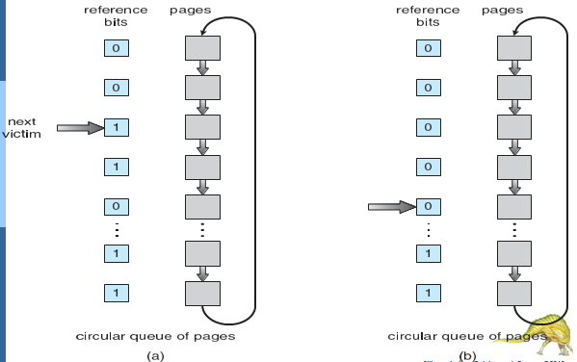
Second-Chance (clock) Page-Replacement Algorithm

Slide 48
Enhanced Second-Chance Algorithm
Improve algorithm by using reference bit and modify bit (if available) in concert
Take ordered pair (reference, modify)
(0, 0) neither recently used not modified – best page to replace
(0, 1) not recently used but modified – not quite as good, must write out before replacement
(1, 0) recently used but clean – probably will be used again soon
(1, 1) recently used and modified – probably will be used again soon and need to write out before replacement
When page replacement called for, use the clock scheme but use the four classes replace page in lowest non-empty class
Might need to search circular queue several times

Slide 49
Counting-Based Page Replacement Algorithms [Reference string = 7,0,1,2,0,3,0,4,2,3,0,3,0,3,2,1,2,0,1,7,0,1 and Memory = 3 frames]
Keep a counter of the number of references that have been made to each page
Not common
Lease Frequently Used (LFU) Algorithm: replaces the page with the smallest count
An actively used page should have a large count value
– But... Pages may be heavily used initially and never used again
Most Frequently Used (MFU) Algorithm: based on the argument that the page with the smallest count was probably just brought in and has yet to be used
Counting-based algorithms are very expensive to implement, and they do not approximate OPT replacement well

Slide 50
Page-Buffering Algorithms
Keep a pool of free frames, always
Then frame available when needed, not found at fault time
Read page into free frame and select victim to evict and add to free pool When convenient, evict victim
Possibly, keep list of modified pages
When backing store otherwise idle, write pages there and set to non-dirty Possibly, keep free frame contents intact and note what is in them
If referenced again before reused, no need to load contents again from disk Generally useful to reduce penalty if wrong victim frame selected

Slide 51
Applications and Page Replacement
All of these algorithms have OS guessing about future page access
Some applications have better knowledge – i.e. databases Memory intensive applications can cause double buffering
OS keeps copy of page in memory as I/O buffer Application keeps page in memory for its own work
Operating system can given direct access to the disk, getting out of the way of the applications
Raw disk mode
Bypasses buffering, locking, etc

Slide 52
Allocation of Frames
Each process needs be allocated a minimum number of frames
Number of page-faults increases as the # of allocated frames decreases The minimum number of frames is defined by the computer architecture
Example: IBM 370 – references 6 pages to handle SS MOVE instruction:
instruction is 6 bytes, might span 2 pages
2 pages to handle from
2 pages to handle to
Maximum of course is the total number of frames in the system Two major allocation schemes
fixed allocation priority allocation
Many variations

Slide 53
Thrashing
If a process does not have “enough” pages, the page-fault rate is very high
Page fault to get page Replace existing frame
But quickly need replaced frame back
This leads to:
Low CPU utilization
Operating system thinking that it needs to increase the degree of multiprogramming
Another process added to the system
Thrashing a process is busy swapping pages in and out

Slide 54
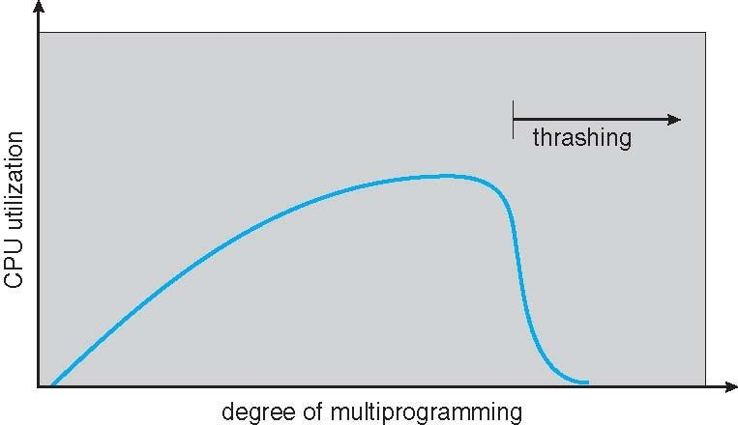
Thrashing (Cont.)

Slide 55
Demand Paging and Thrashing
Why does demand paging work?
Locality model
Process migrates from one locality to another
Localities may overlap
Why does thrashing occur?
Σ size of locality > total memory size
Limit effects by using local or priority page replacement

